Slide 1
Fantastic Figures and Where to Find Them
Download Inkscape
Go to
github.com/nrokh/FiguresDemo2022
To get started:

Slide 2
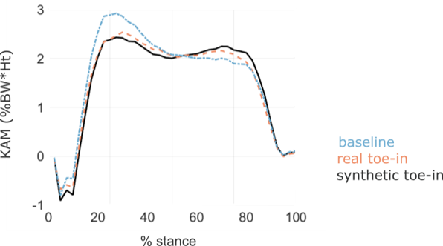
Why do good figures matter?
Qualifying exam
The same content, published

Slide 3
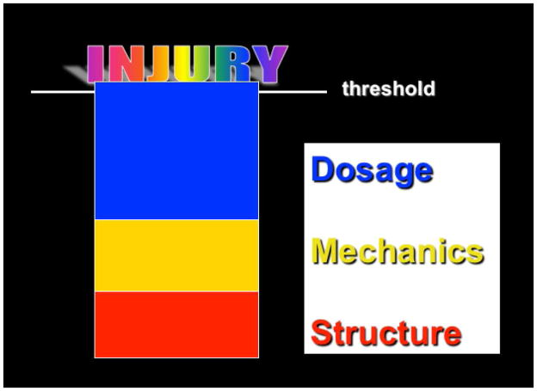
Why do good figures matter?
Give your work the honor of being immortalized beautifully
Makes your reader trust you and your conclusions
More trust -> more engagement with your work

Slide 4
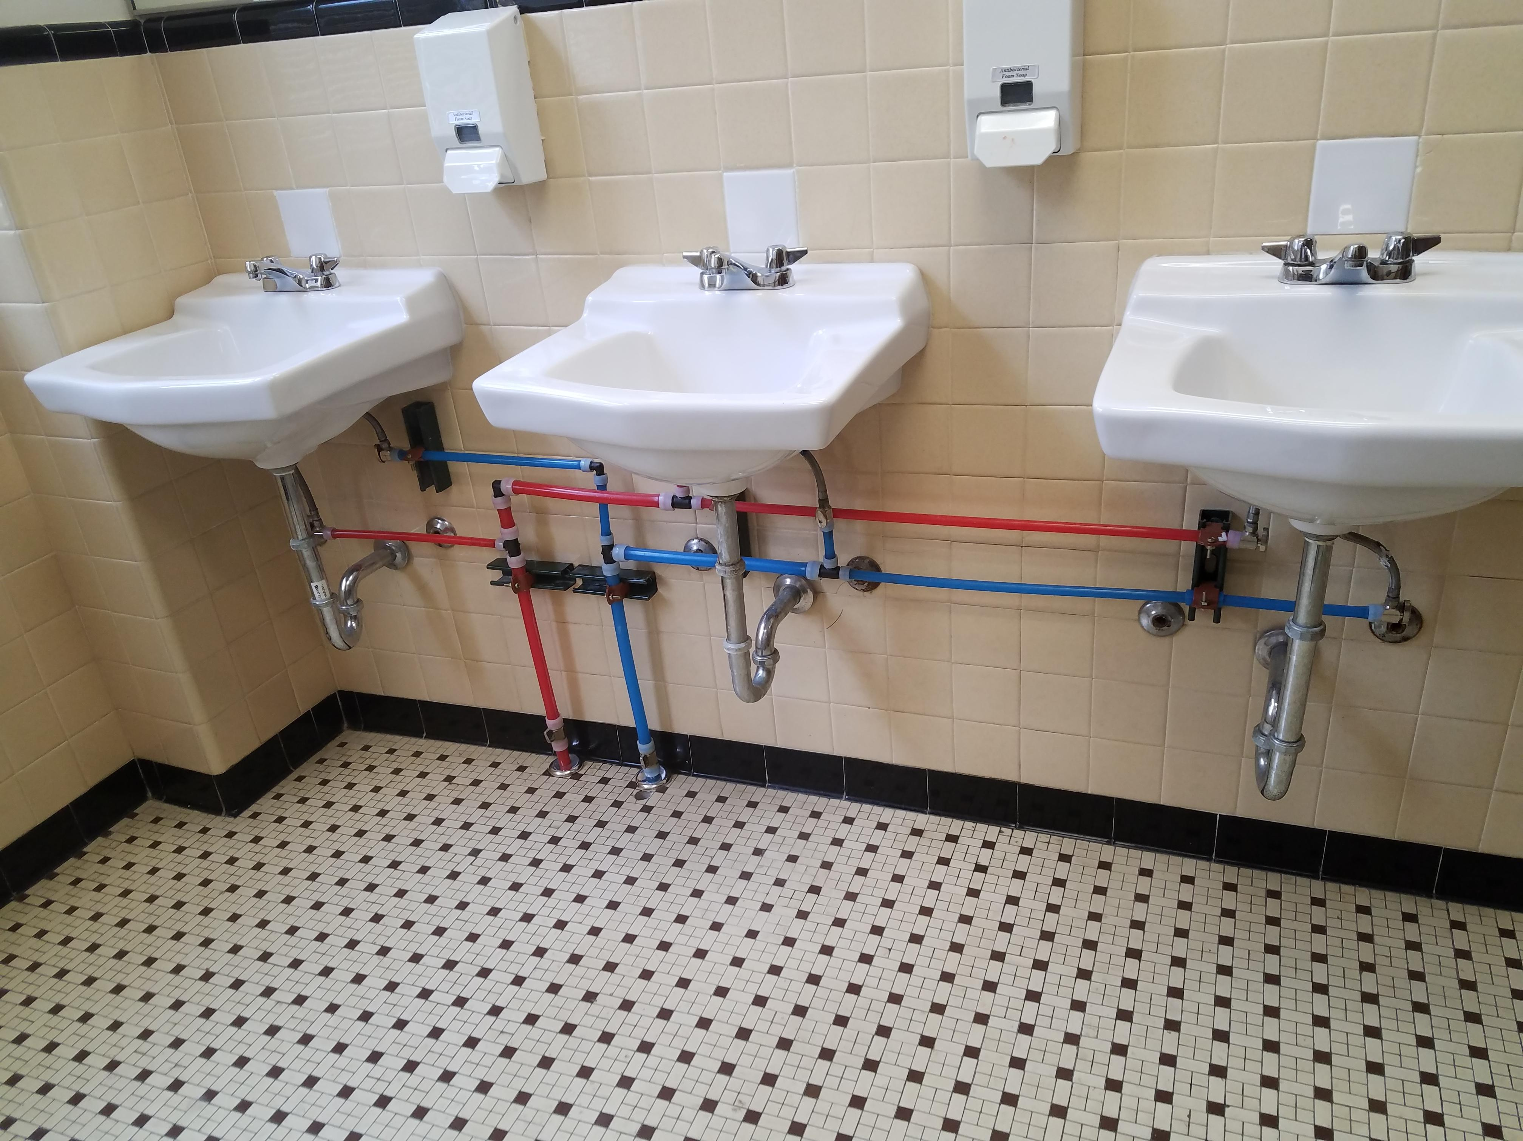
Semiotics: the study of signs, symbols, meaning
A sign is something that communicates meaning or significance
Introduce the reader to your conventions: the stylistic choices that will be consistent throughout
Semiotics: red=hot; blue=cold tap
What do dashed vs solid lines mean? What are transparent dots vs solid dots?
/r/MildlyInteresting

Slide 5
Essentials and Examples

Slide 6
Image resolution: low-hanging fruit
Export at high-resolution
Work with lossless formats:
PNG is fine
TIF is likely required for submissions
SVG is for vectors
NEVER JPEG
Take photos in RAW so you can edit them fully

Slide 7

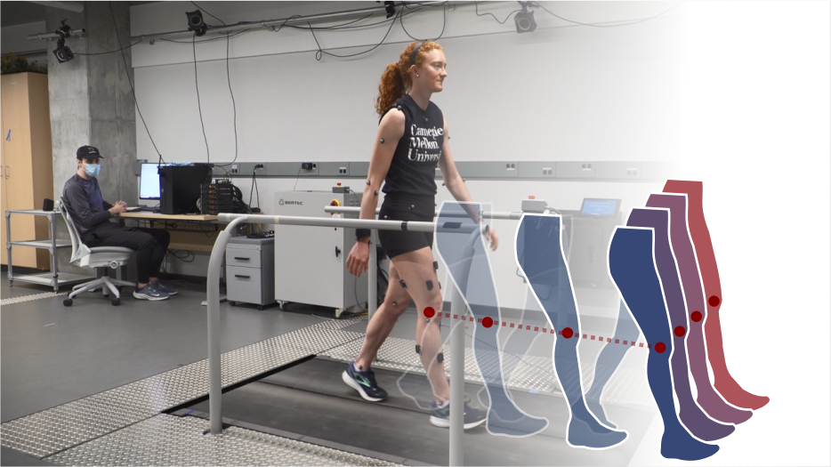
Image resolution: low-hanging fruit
75 dpi
934 x 525 pixels
7.5 dots per inch (dpi)
93 x 52 pixels
Notes:
Pixel: smallest addressable element of a picture represented on a screen
DPI: dots per inch, a measure of the resolutoin

Slide 8
Font size: check for readability
Papers
Posters
Presentations
Figure font should not be much smaller than body font size
Check how it looks embedded in your document
Readable at several distances/levels of engagement
Usually need to increase size
Don’t just copy-paste paper figures into a talk
Save your figures in an editable format!

Slide 9
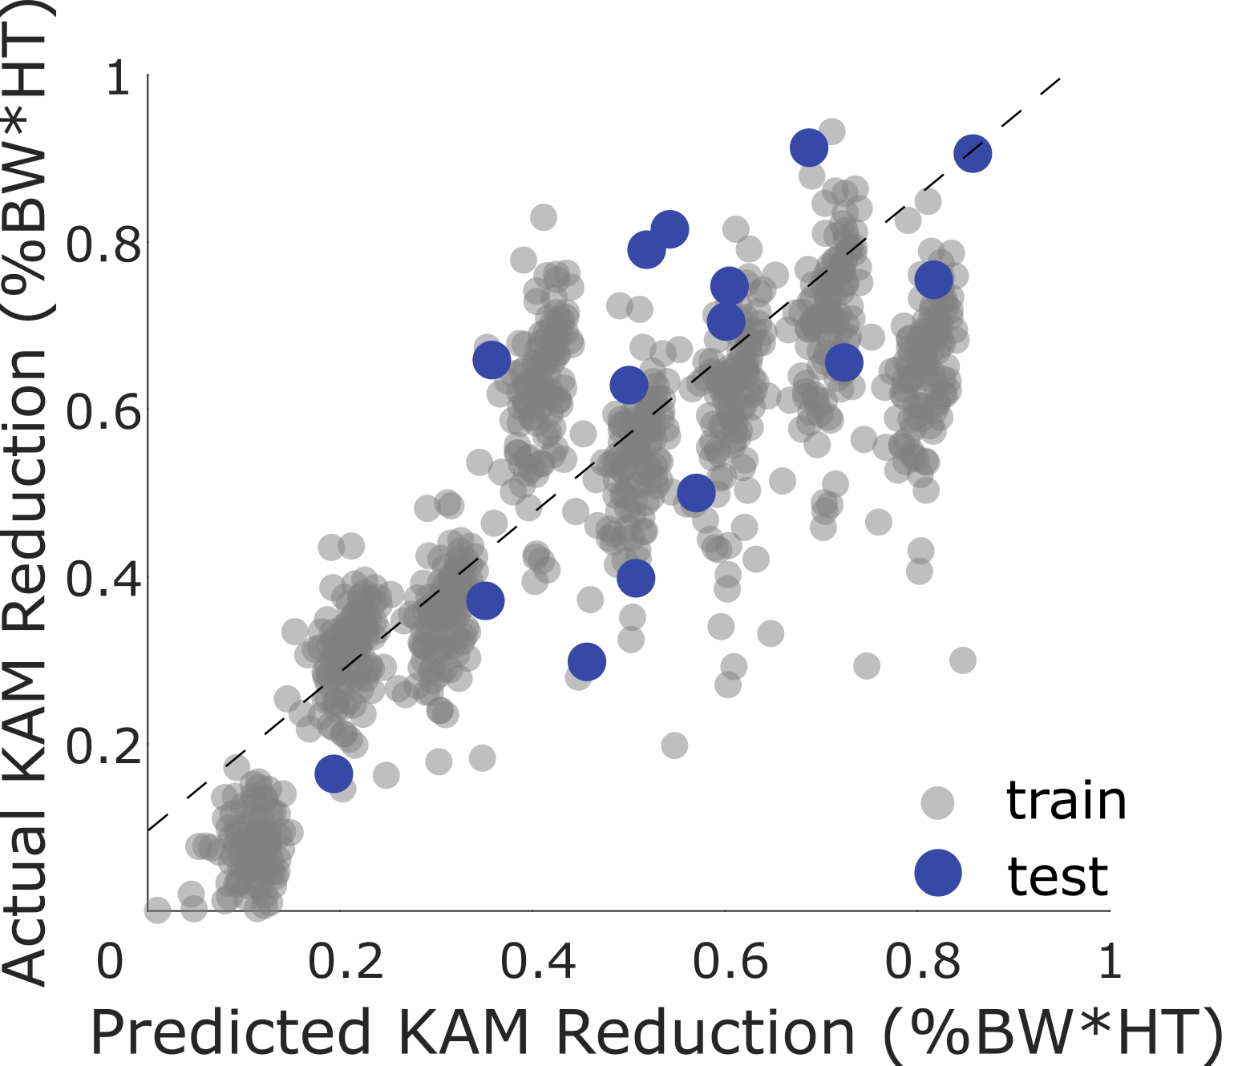
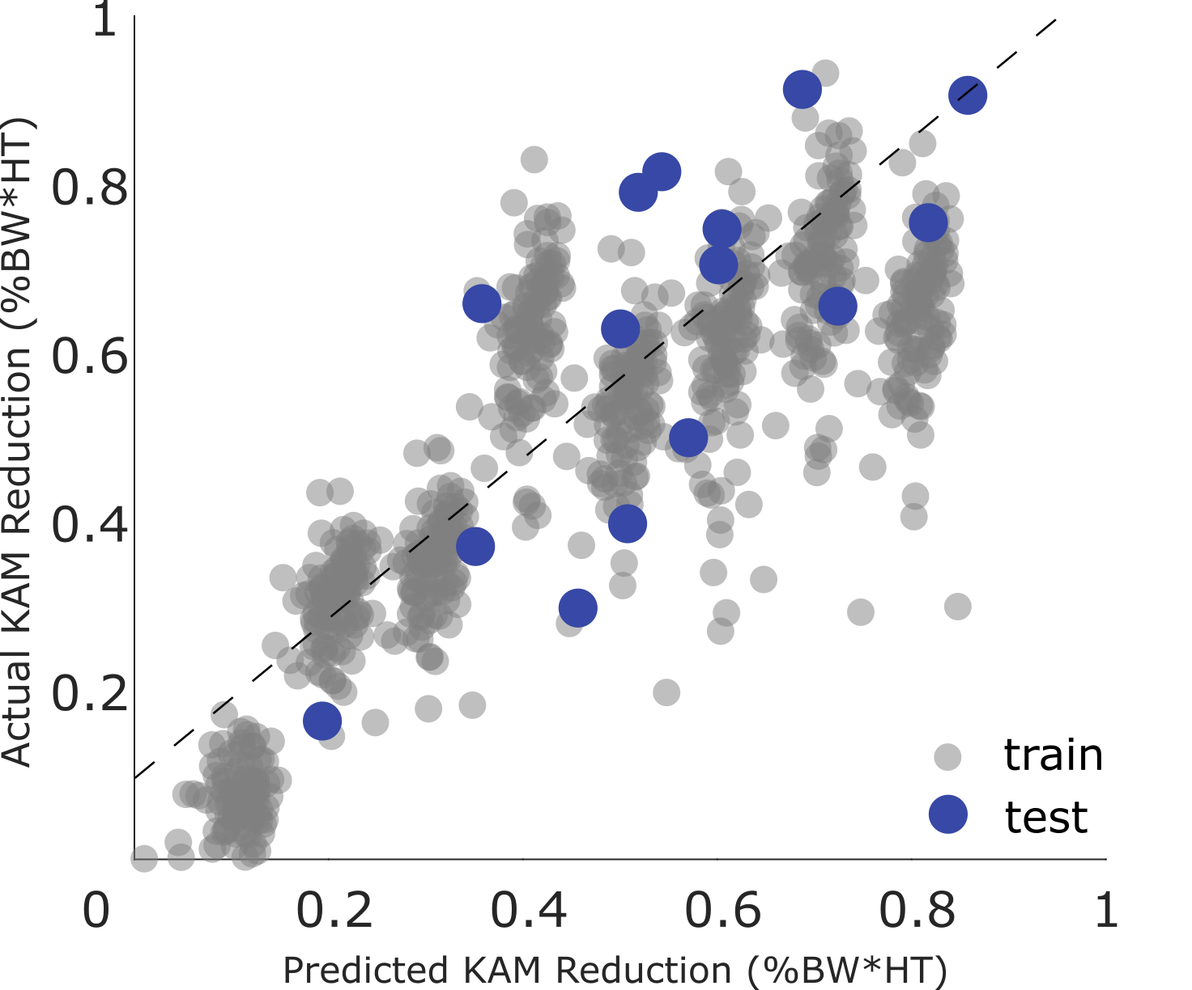
Font size: check for readability

Slide 10
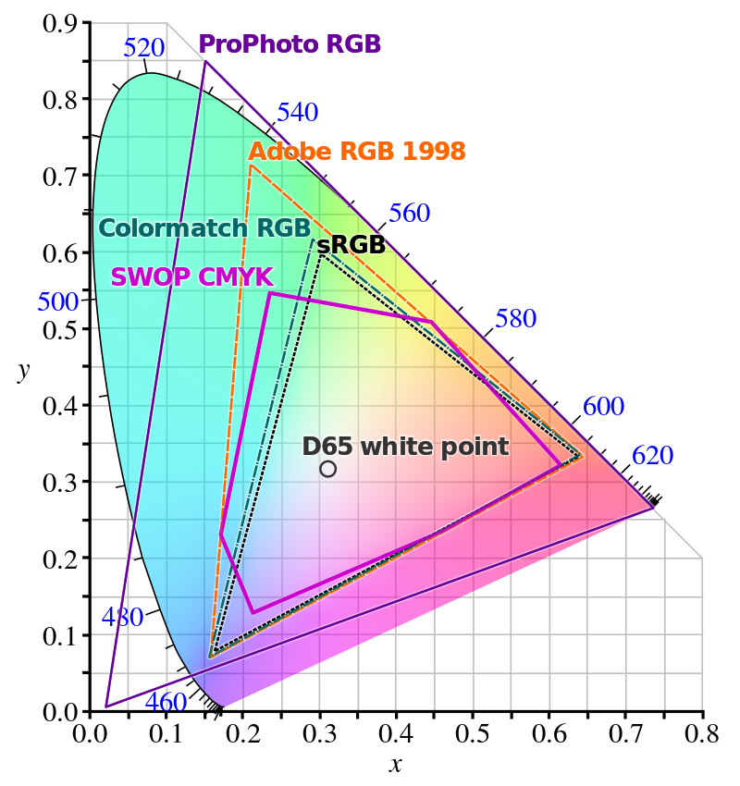
Color choice: picking your paper palette
Muted or desaturated appears more professional
Consider color vision deficiency
1 in 12 men and 1 in 200 women
Browser extensions or sites
Printing in black and white?
Spend some time picking your color palette
coolors.co
Chromaticity diagram: color models can differ across gamuts (e.g. RGB vs CMYK)

Slide 11
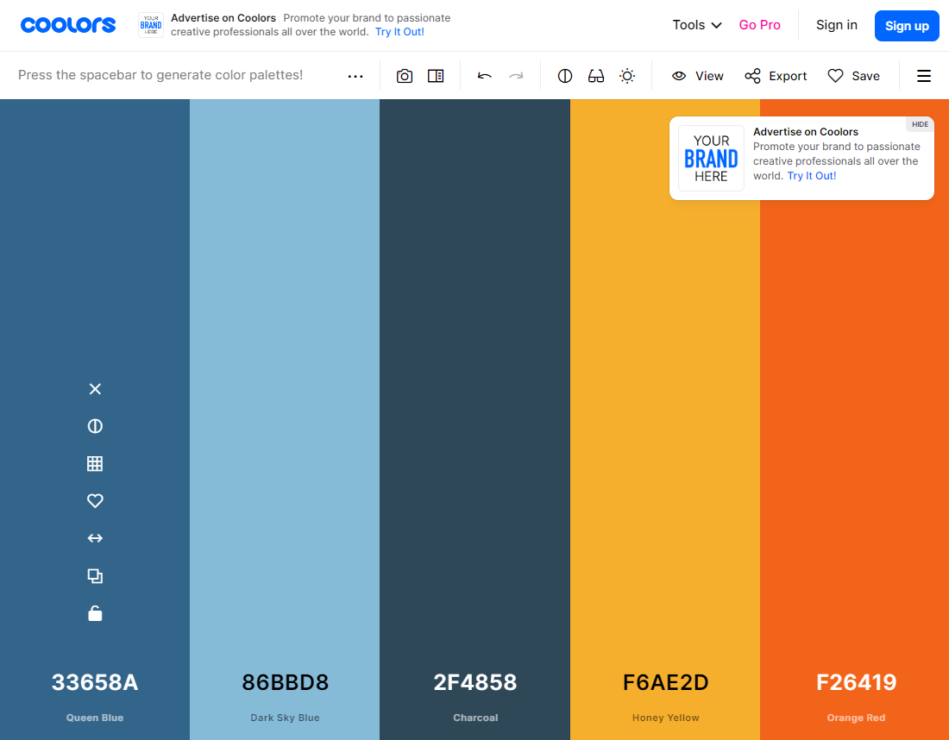

Slide 12
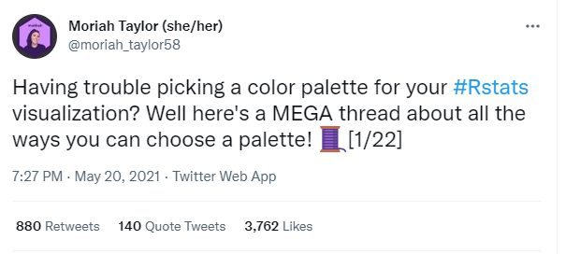
A great Twitter thread on colors and packages:
https://twitter.com/moriah_taylor58/status/1395431000977649665

Slide 13
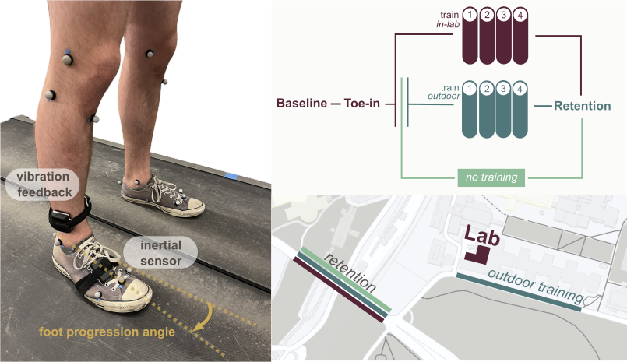
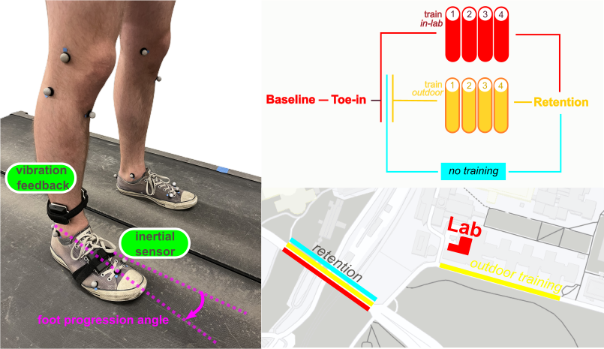
Color choice: picking your paper palette
Just painful to look at
Much better

Slide 14
Ink to Content ratio: keep it small
“Ink” means:
Boxes, lines, grids
Unnecessary or redundant labels or text
Bounding boxes around legends
Content:
Your hard work!

Slide 15
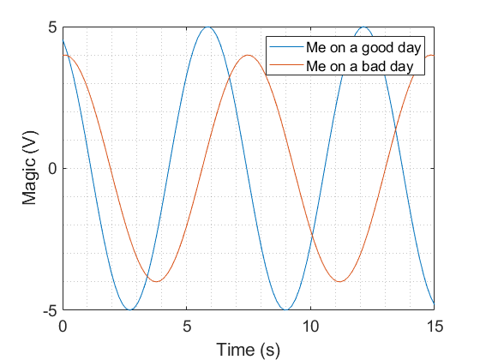
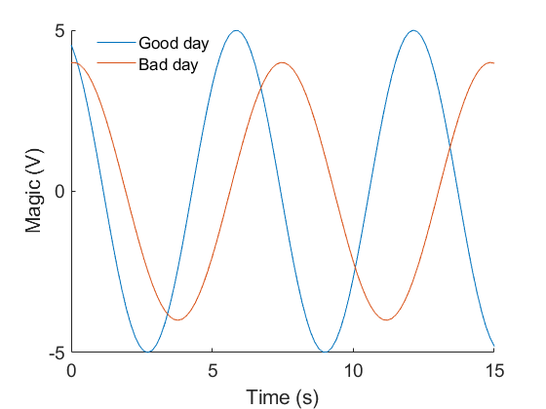
Ink to Content ratio: keep it small

Slide 16
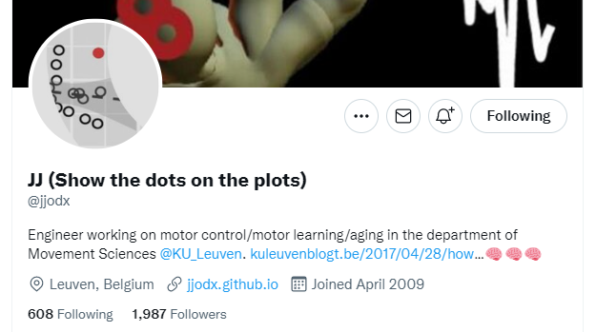
Maximize clarity and consistency
Consistency:
Color palette
Font throughout
Same signaling elements (reiteration)
Clarity:
Pick the best visualization for your data
If visualizing averages, “show the dots on the plots”

Slide 17
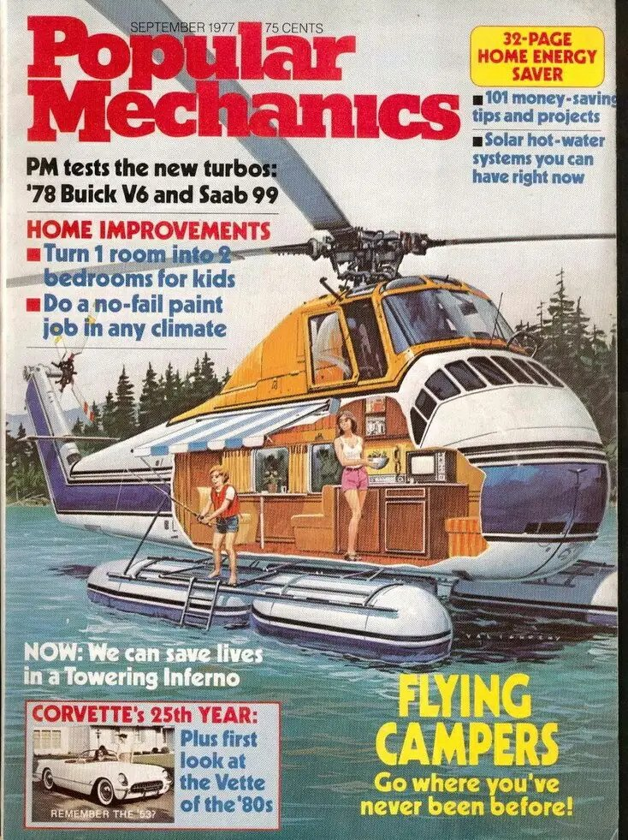
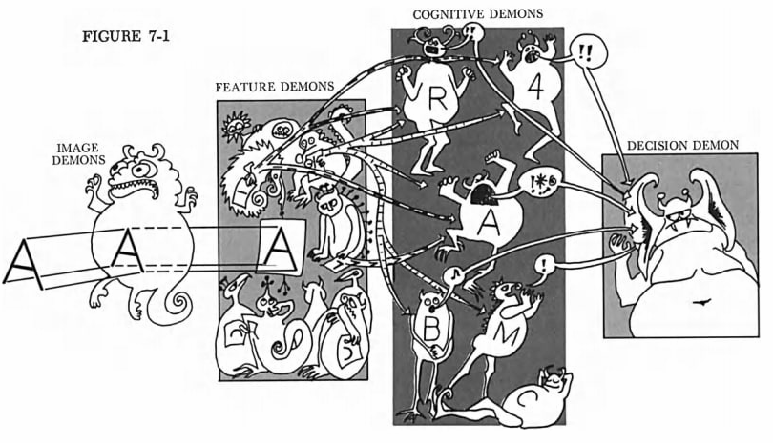
Get inspiration from diverse sources
Human Information Processing (Norman and Lindsay)
Popular Mechanics 1977

Slide 18
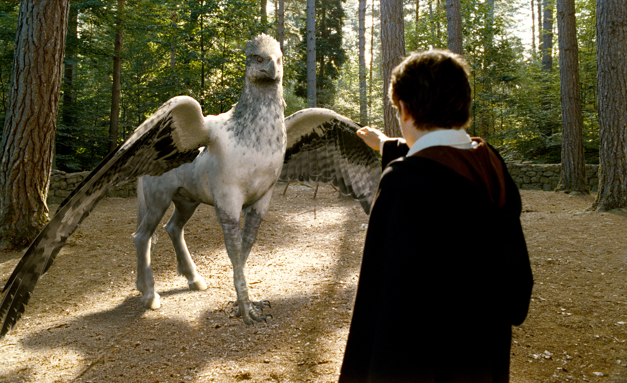
Hybrid Figures
Is it a horse? Is it a bird? Is it an illustration? Is it a plot?

Slide 19
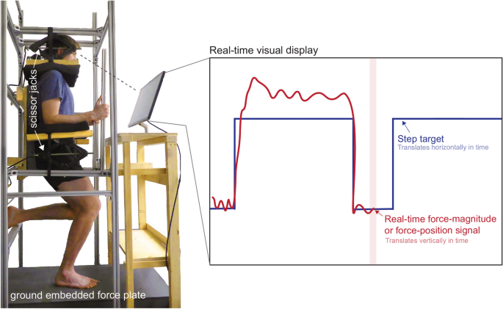
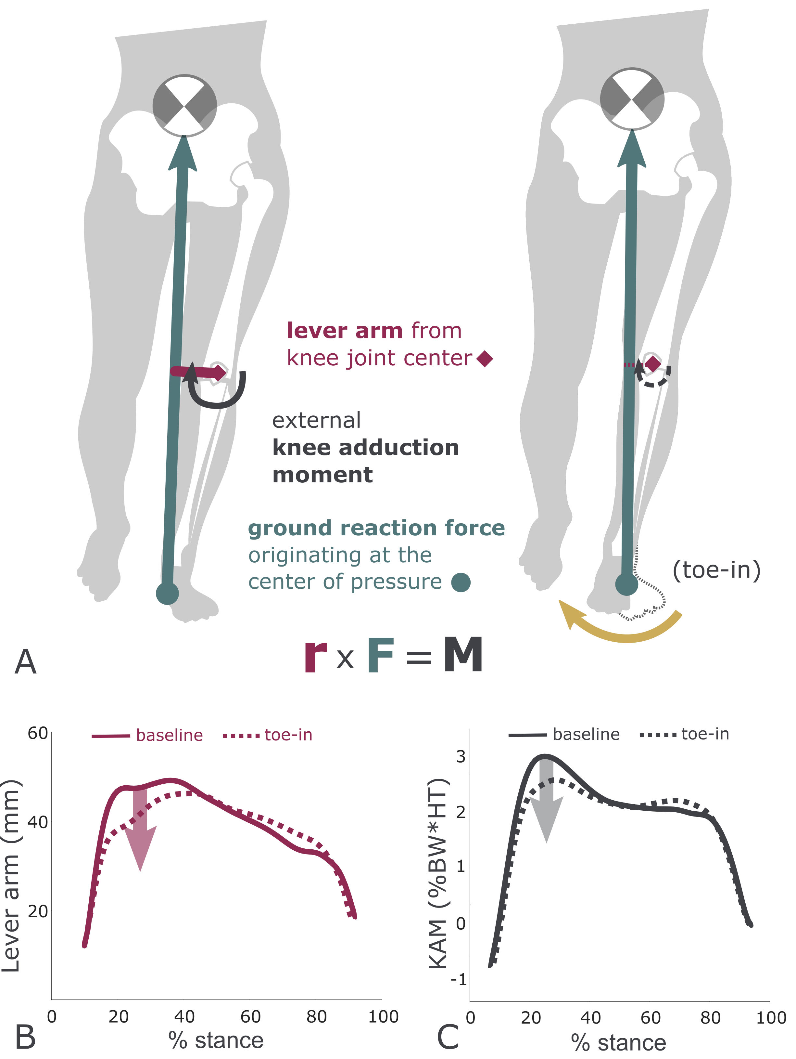
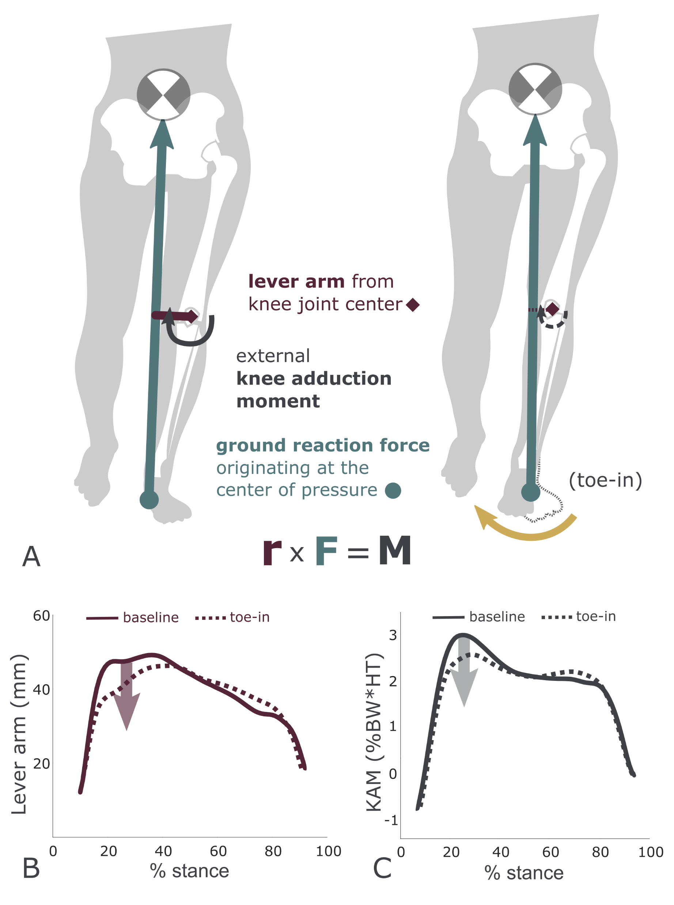
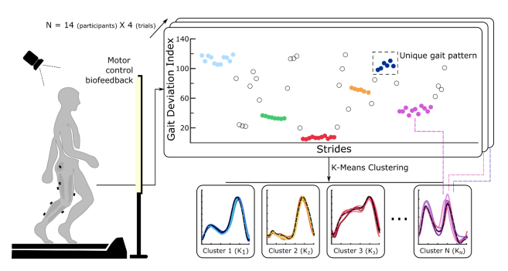
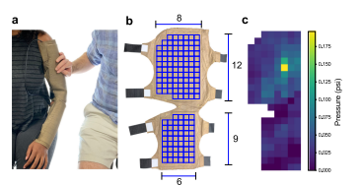
Kudzia 2022
Rokhmanova 2022
Spomer 2022
Salvato 2021

Slide 20
Hybrid figures
Concept/experimental setup AND a result/data
Can be effective as a first figure
visual equivalent of the last paragraph of the introduction section
(in this paper we…)
If it’s the first thing the reader sees, make it a crowd-pleaser
Best of both worlds between methods and results
To Inkscape!

